Slide 1
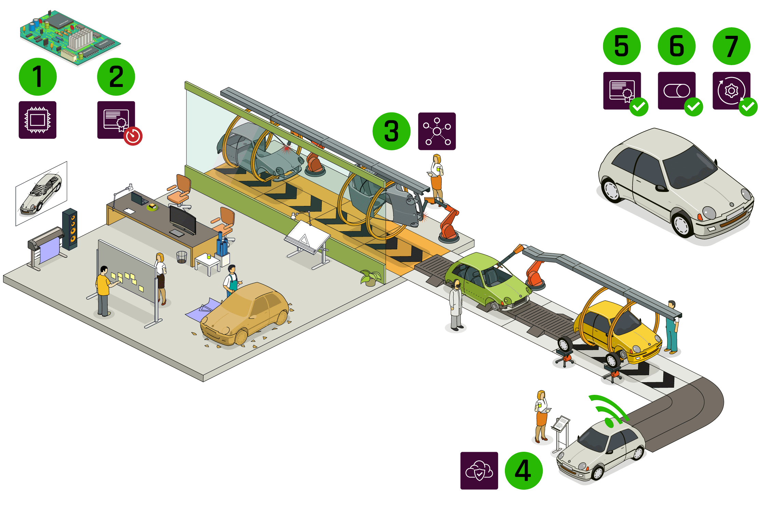
Project: Safe Root IOT

Slide 2
Group Member
Name : Palash Ahmed
Department of Computer Science & Engineering, JU
Batch:49
Name : Monirul Islam
Department of Environment Science, JU
Batch:49
Name : Abu Said Mohammad Readwanul
Department of Computer Science & Engineering, JU
Batch:50

Slide 3
Introduction
Ensuring safer journeys with IoT-powered collision detection, smart street lighting, and driver drowsiness prevention, our intelligent system detects obstacles, prevents collisions, and adapts lighting to traffic conditions—reducing energy consumption while enhancing visibility. With real-time alerts for driver fatigue and AI-driven monitoring, we create a safer and more efficient transportation ecosystem.

Slide 4
Objectives
Prevent Road Accidents – Detect obstacles and provide real-time collision alerts to minimize crashes.
Enhance Driver Safety – Monitor driver fatigue and issue instant alerts to prevent drowsy driving.
Enhance Driver Safety – Monitor driver fatigue and issue instant alerts to prevent drowsy driving.
Optimize Street Lighting – Implement smart lighting that adapts to traffic conditions, reducing energy consumption while improving visibility.
Create a Connected Transportation System – Utilize IoT and AI to ensure seamless communication between vehicles, infrastructure, and drivers for a safer and more efficient journey.

Slide 5
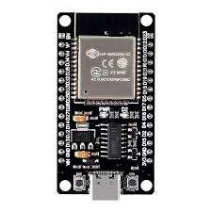
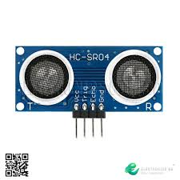
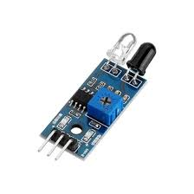
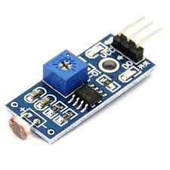
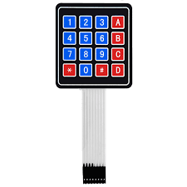
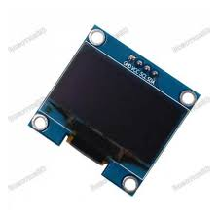
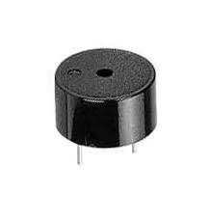
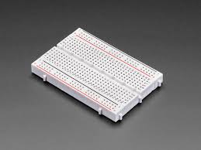
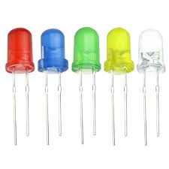
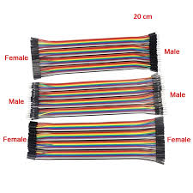
Components
ESP32
Ultrasonic Sensor
IR Sensor(3)
LDR Module
Keypad
OLED Display
Buzzer
LED
Jumper Wire
Breadboard

Slide 6
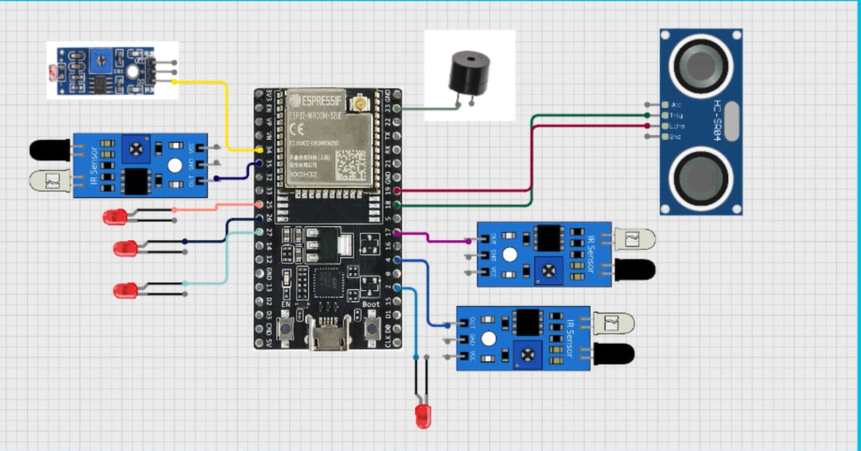
Circuit Diagram

Slide 7
Working Procedure
(Driver Drowsiness)
System Initialization
The program starts by establishing a serial communication between the computer (Python) and the ESP32 using the pyserial library.
Haar cascade classifiers for face and eye detection are loaded from the given file paths.
The system initializes the webcam (camera) to continuously capture frames.
Alert Mechanism with ESP32
When drowsiness is detected, the system sends a signal (‘1’) to the ESP32 via serial communication.
The ESP32 activates a buzzer and LED to alert the driver.
If the driver opens their eyes, the system resets the counter and sends a ‘0’ signal to turn OFF the buzzer.
Face and Eye Detection
The system detects the face using the haarcascade_frontalface_default.xml file.
Once a face is detected, the system detects eyes using haarcascade_eye.xml within the face region.

Slide 8
Working Procedure
(Smart Street Lamp)
System Initialization
The ESP32 starts serial communication at 9600 baud rate.
It configures the LDR sensor, IR sensor and LED
Smart Street Lamp System
The LDR sensor measures light intensity, and the IR sensor detects motion.
If it’s dark and motion is detected, the LED turns ON; otherwise, it remains OFF.
Ensures energy efficiency by turning off lights when not needed.

Slide 9
Working Procedure
(Collision Detection)
System Initialization
The ESP32 starts serial communication at 9600 baud rate.
It configures the ultrasonic sensor, LED, and buzzer.
Collision Prevention System
The ultrasonic sensor measures distance to obstacles.
If an object is ≤ 10 cm away, the buzzer and LED turn ON as a warning.
If the area is clear, the buzzer and LED remain OFF.

Slide 10
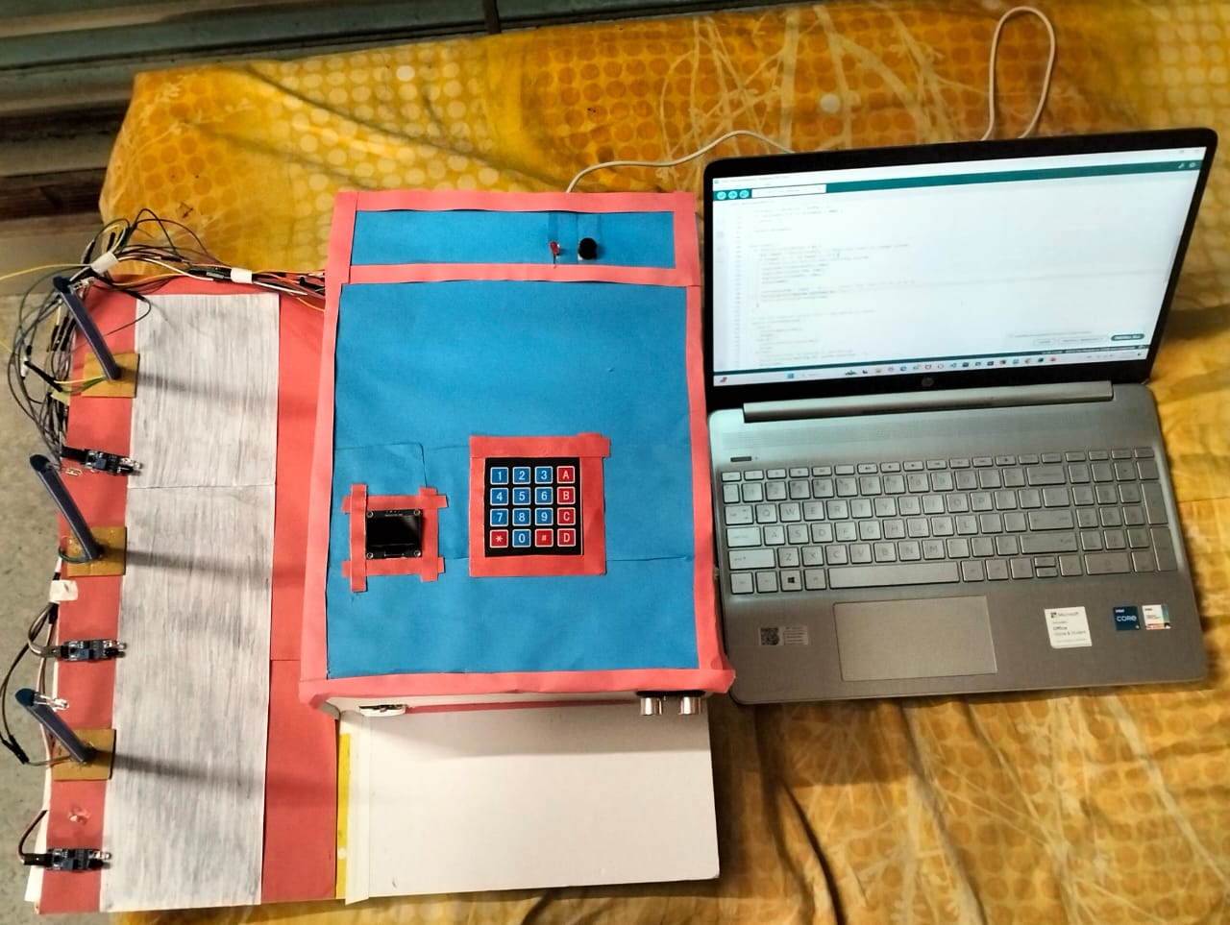
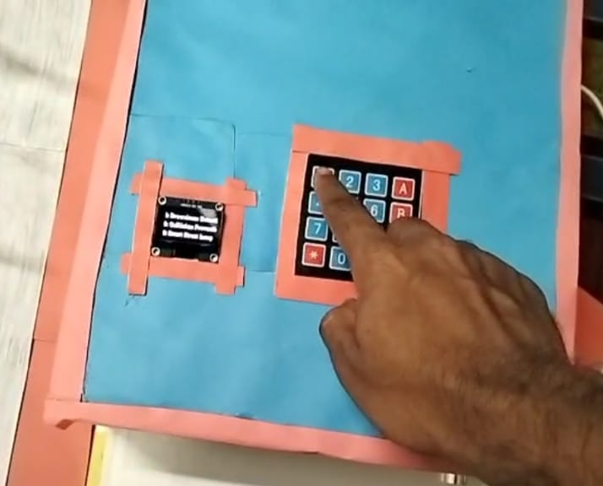



Practical Part Of Our Project

Slide 11
Future Aim Of Safe Root IOT
Autonomous Accident Prevention – Enhance real-time collision detection with AI-powered predictive analytics to prevent accidents more effectively.
Integration with Smart Cities – Connect with intelligent traffic management systems for seamless communication between vehicles and infrastructure.
Enhanced Driver Assistance – Develop a more advanced driver monitoring system with AI-driven facial recognition and biometrics for fatigue detection.

Slide 12


Slide 13


